Slide 1
The value of international studies
Global and national perspectives
Anne-Berit Kavli
Chair, IEA

Slide 2
Introduction
Why international studies?
Overview of IEA
Aims
Studies
Members
Lessons learned
Experiences from Norway

Slide 3
Aims of surveys of educational achievement
Description:
Levels of achievement for the population and for subgroups of the population
Trends in levels of achievement over time
Explanation:
Determine causal effects of different factors on achievement in and out of the educational system
Understand the causal mechanisms through which determinants influence achievment. This requires explanatory and predictive theories of educational processes and mechanisms.
Both description and explanation are fundamental to improvement of education
Jan Eric Gustavsson

Slide 4
Secondary analysis of international surveys
The cumulated data from the international surveys offers an extremely rich empirical basis of high quality data for explanatory research
The international data offer considerable advantages:
Such data permit exploitation of variation that only exists across countries, or where the variation within countries is limited.
Comparable estimates can be obtained for a diverse set of countries, which throws light on the generalizability and heterogeneity of effects,
The data can be analyzed at different levels of aggregation, from the individual level to the educational system level.
Jan Eric Gustavsson

Slide 5
Aims of IEA
Through its world-wide comparative research and assessment projects, IEA
provides international benchmarks that identify strengths and weaknesses in educational systems;
provides high quality data that point to key factors that influence teaching and learning;
provides high quality data that direct educational reforms;
develops educational systems’ capacity to engage in national strategies for monitoring and improving performance;
contributes to research in educational evaluation, developing a world-wide network of researchers in this critical area.

Slide 6
IEA today
69 member institutions all over the world
High professional competence both in the IEA Data Processing and Research Center and the international study centers
Studies are well regarded and participation in trend studies is high
Country diversity is very high
Only international actor on primary level with TIMSS and PIRLS
Class based samples gives unique analytical possibilities
TIMSS gives a unique (and underused?) possibility to analyze development from grade 4 to grade 8 for the same cohort

Slide 7
IEA studies
IEA studies focus on the output of educational systems—that is, the educational achievements and attitudes of students after a fixed period of schooling, usually the fourth and eighth grades.
Studies are designed to understand the linkages between:
intended curriculum (what policy requires)
implemented curriculum (what is taught in schools)
achieved curriculum (what students learn).
Class based studies gives opportunity to link learning outcomes with instruction and learning environment

Slide 8
Overview of IEA Studies
Trend studies:
TIMSS and TIMSS Advanced
PIRLS
ICCS
New studies:
ICILS
ECES
Pre PIRLS
TIMSS Numeracy

Slide 9
IEA studies consists of
Cognitive tests based on curricula of participating countries
Extensive questionnaires about instructional practices, student and teacher attitudes and dispositions, and more general background information related to school environment, teachers, and students.
The background data allow policy analysts and researchers to identify and implement those factors that enhance the learning process and achievement outcomes.
The cycle of studies gives countries an opportunity to monitor progress in educational improvement over time.
Trend information is crucial in helping policy makers understand the impact of decisions about investment in education, curricular reform, and initiatives to improve instruction

Slide 10
Different study approaches
IEA studies
Classroom based, measures outcome of schooling
Curriculum related
Background surveys to pupils, teachers, principals and parents
Links teaching, learning environmets and learning outcomes
Trend studies
OECD – PISA
Age and school based
Measures achieved competencies necessary for further schooling and work
Background surveys to students and principals
Core study plus optional modules
Trend study
All studies are based on matrix sampling and advanced psychometrics, but yield a different basis for analyses.

Slide 11
Correlation between score and age for OECD countries in PIRLS 2011

Slide 12
Future challenges
Encourage continued and improved research that provides explanatory causal results
Keep the good quality of the cognitive tests in the studies
Improve surveys and analytical methods
Strengthen focus on capacity building within countries
Change vs continuity?
Testing for the future – what does that mean?
What about non cognitive skills?

Slide 13
What about Norway?

Slide 14
Education system in Norway
Primary and lower secondary education is based on the principle of an equal and adapted education for all in an inclusive unified school.
Compulsory schooling in Norway lasts for ten years, and the children start school the year they are six years old.
All children have a statutory right to upper secondary education – either general or vocational
Common core curriculum – “Knowledge Promotion”
The municipalities fund primary and lower secondary education and have a great deal of freedom when it comes to organising the education.

Slide 15
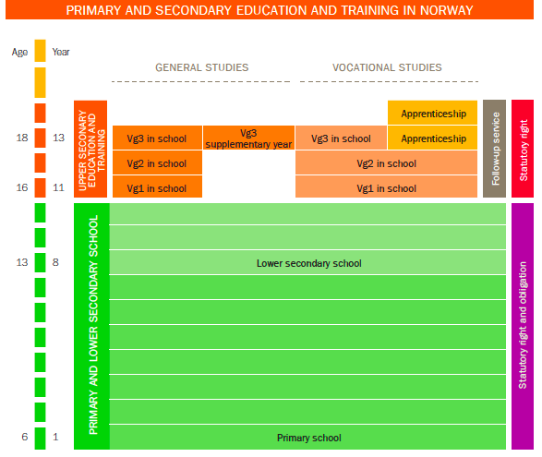

Slide 16
The Norwegian Experience
Long time participation in most IEA studies and in PISA
Facing decline in pupils achievement results from 2000 and onwards
“PISA-shock” in 2001
Decline resulted in several national actions:
National strategy for improving reading literacy
New Quality Assessment System 2004
Curricular reform 2006 – Knowledge Promotion
Competence development strategies for teachers
Support systems for schools and municipalities
Strong educational debate and increased focus on learning outcomes
Improving results since 2006

Slide 17
Development of outcomes in Norway

Slide 18
Knowledge Promotion 2006
Major curricular reform from grade 1 through grade 13
The reform aimed to
Strengthen basic skills in reading, writing, mathematics, digital competence and oral skills
Clarify learning goals in all subjects
Give increased local freedom to organize schools, choose instructional methods, textbooks and teaching materials
Professional development for teachers and principals
Assessment for learning
The reform was evaluated by a large scale research programme in the period 2006 - 2012

Slide 19
What has been achieved?
Wide agreement among policymakers, school authorities and teachers about intentions and main content of the reform
Increased attention on basic skills
Improved responsibility, leadership and awareness from local school authorities
Changed and improved assessment practice – assessment for learning

Slide 20
Continued challenges
Ongoing professional development for teachers and principals
Increased focus on instructional methods and classroom leadership
Continued attention on basic skills, assessment for learning and an adapted an inclusive school system
Further development of the system for quality assessment

Slide 21
The fundamental question
National policy
School authorities
School
Parents
Teachers
How to stimulate effective learning?
Notes:
Skyldunámið er á ábyrgð ríkisvaldsins. Hvað fólk gerir eftir það er þeirra mál.
Efniviður samfélags framtíðarinnar
Mat á mannauðnum við lok fyrsta áfanga menntunar (skylduáfanganum).
Mannauður skilgreindur af OECD:
“Þekking, færni, hæfni og aðrir hæfileikar sem einstaklingar hafa til að bera og skipta máli fyrir persónulega, félagslega og efnahagslega velferð.”

